Slide 1

Social Media Usage and Emotional Well-Being
Project 1 Group 2:
Cindy Duong
Daniel Cabrera
Jennifer Vega
Zilan Yildiz

Slide 2

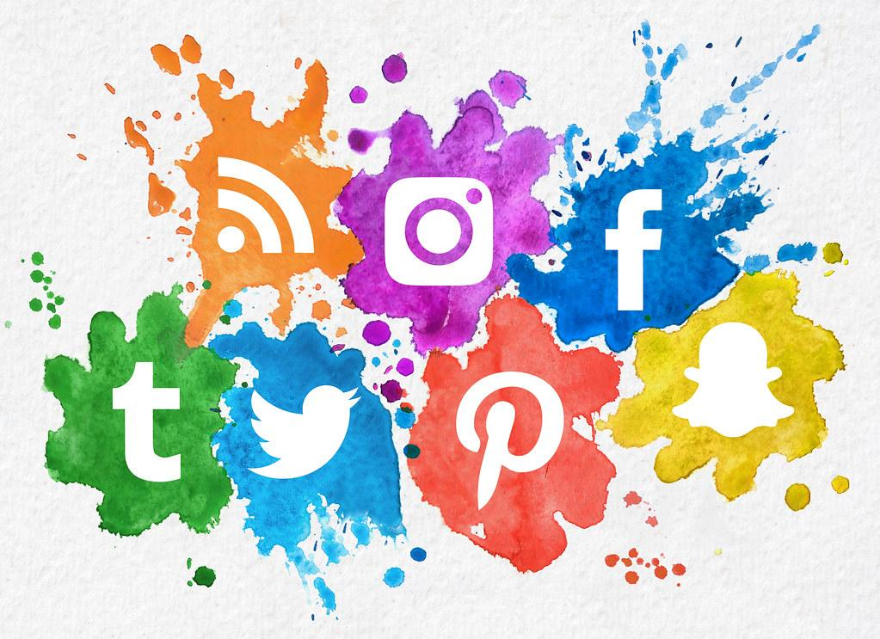
Social media has grown to become part of our modern day-to-day lives having an influence over various aspects of our emotional well-being.
We will be exploring the data on Social media and emotional well-being.
We seek to find any relationships, among the data, that may exist between these variables.
We can only draw conclusions from the data.
Columns within the Data Set:
Demographic columns: User ID, user’s Age, user’s Gender
Social Media Data columns: Platform App, Daily Usage Time, Average Posts, Likes Received, Comments Received, and Messages Sent per day.
Emotional State: Dominant Emotion

Slide 3

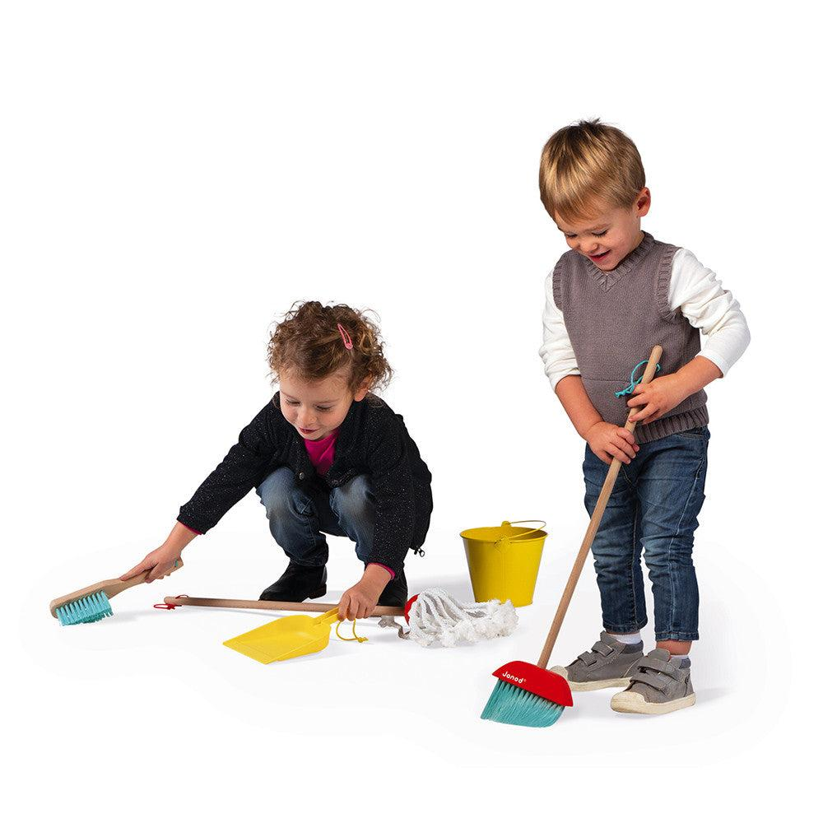
Raw Data issue: There was a subsection of data from the ‘Age’ column that appeared to be switched with the values from the ‘Gender’ column
Discussion Topics:
Will Booleans work?
We may need to store it in a list first.
Use ‘for loop’ to capture all rows in ‘Age’ Column that are string maybe? But where do we go from there?
Resolutions:
We needed to use ‘.isin()’ for the 3 gender categories available to us
Renamed Age to Gender and Gender to Age
Concatenate the data and drop the nulls
Lets clean the data!

Slide 4
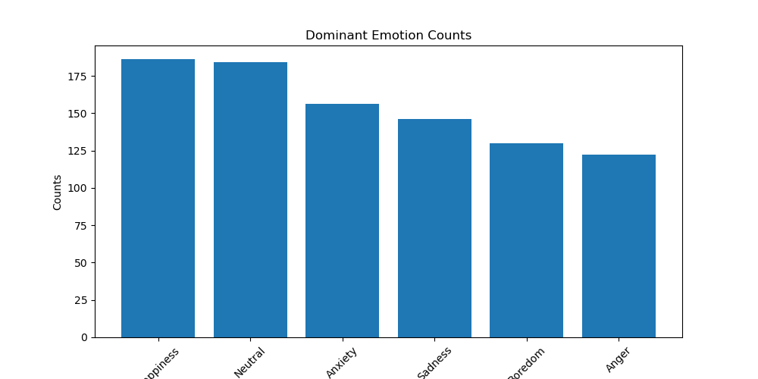
Are emotion and age connected when it comes to social media usage?
Used age and emotion to measure if there was a connection between the two.
The first graph gives us a count of the how many people were split by each emotion.
From here we can tell that Happiness is the largest sample size and anger is the smallest.

Slide 5
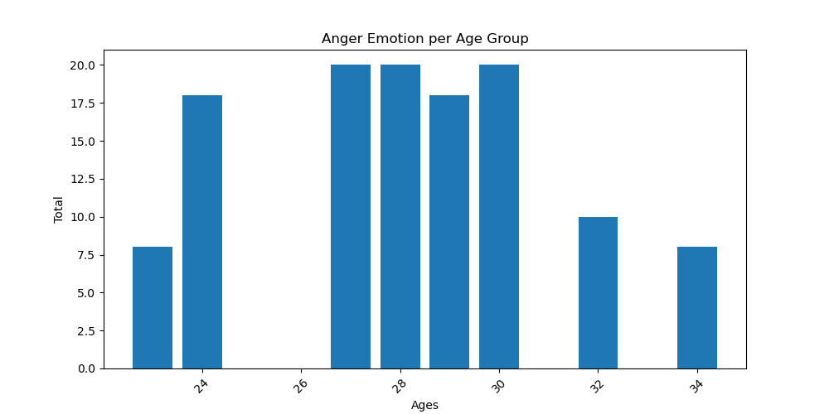
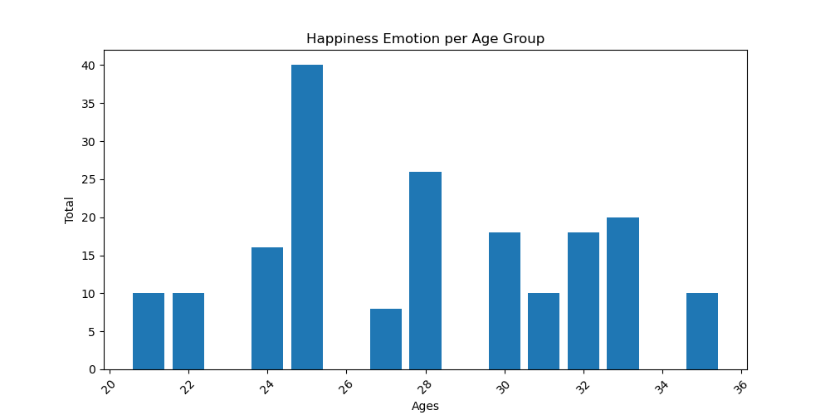
Created a DataFrame that solely focused on anger.
As can be seen in the graph on the left, we have the majority of the numbers being in the 27-30 year old age group.
Even when looking at our median age of 27, the largest group was in anger.
We also created another DataFrame focused on Happiness.
As we can see there is a larger spread amongst all the age groups with one outlier being the 25 year olds.
We concluded that age is not a factor for emotions while using social media.

Slide 6
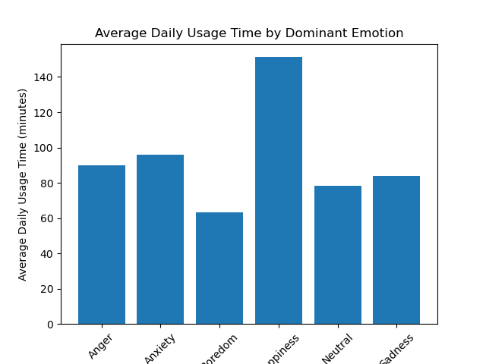
What emotion affects time spent on social media the most?
To create this DataFrame we took, Dominant Emotion, Daily Usage Time and Gender to analyze
When looking specifically at Emotion and Usage, we found that Happiness has an affect on usage.
If the person was feeling happier they tended to use social media for a longer period of time.
Boredom on the other hand was the emotion that caused the least amount of time used.

Slide 7
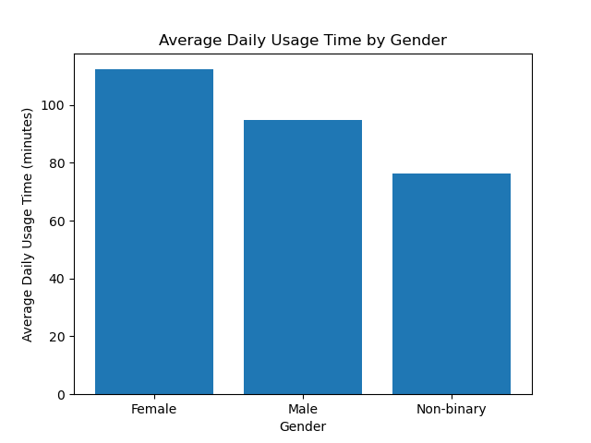
Which gender spends the most amount of time on social media?
We then switched to another data frame to look at gender and usage time.
We found that females spend more time on social media with the average being 112 minutes.
Men spent about 94 minutes on average.
Non-binary individuals spent about 76 minutes on average.

Slide 8
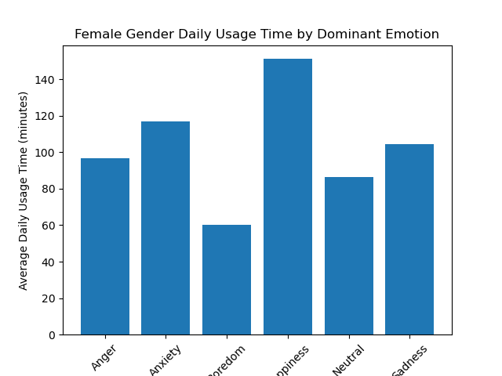
Which gender is affected the most by their emotions when it comes to using social media?
We then switched our analysis to focus on each gender specifically.
Females that spent the most time on social media when happy averaged 151 minutes.
Males spent about about 153 minutes on average when happy.
Non-Binary Individuals spent about 143 minutes when happy.

Slide 9
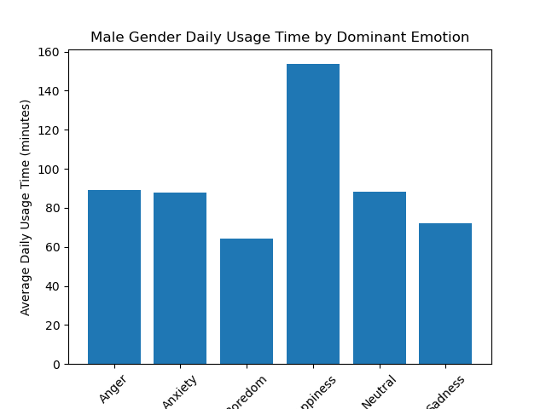
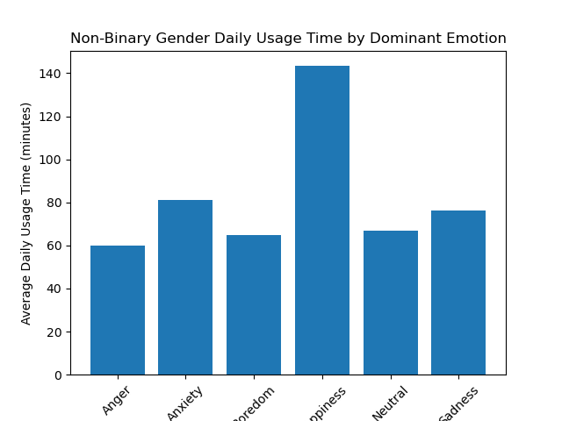
For males anger was the second most dominant emotion by time spent with them averaging 89 minutes spent on social media while angry
For females and non-binary the second most dominant emotion was Anxiety, with females averaging 117 minutes and non-binary at 81 minutes

Slide 10
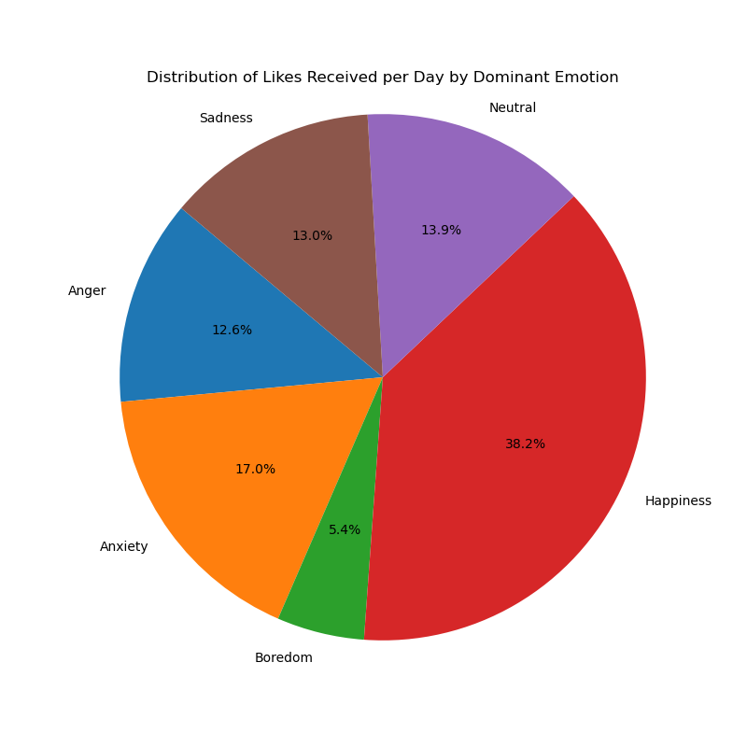
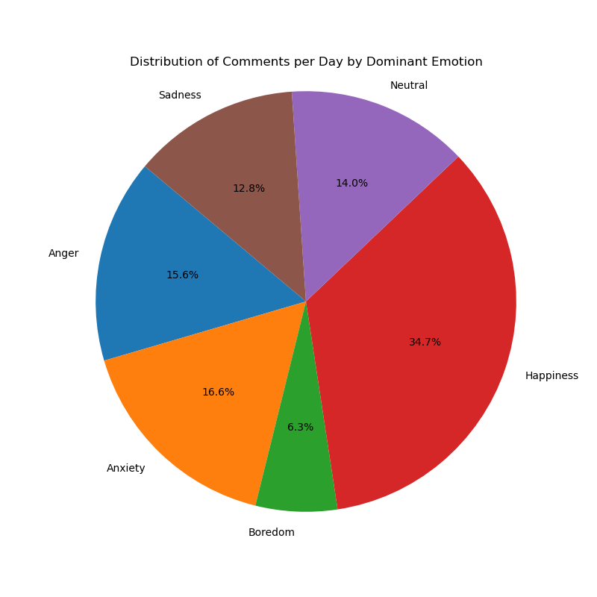
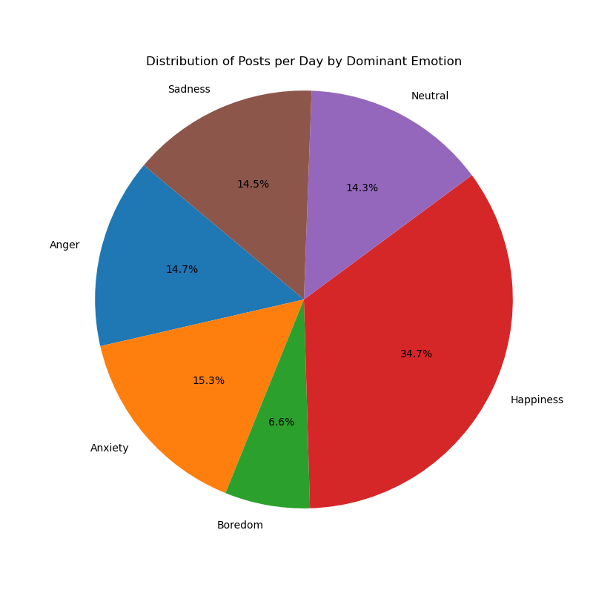
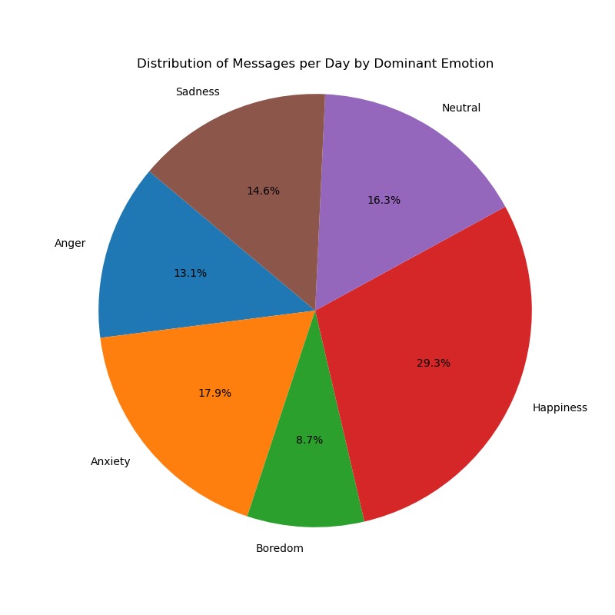
Does emotion have an effect in how social media is used ie. Likes, comments, posts?
The Data Frame for this analysis used the following columns: "Posts Per Day", "Likes Received Per Day", "Comments Received Per Day", and "Messages Sent Per Day"
The data was split at each column at compared to all emotions that were present in the Data Set: Happiness, Anxiety, Sadness, Neutral, Boredom and Anger
We used Pie Charts to map out the percentages of each emotion within each of the columns mentioned above.
As mentioned previously, happiness does have an effect on how much usage and interaction a person does while using social media avg. about 28-38%.
We also see that boredom is the emotion that has the least amount of interaction averaging between 5-8% total interactions.
Anxiety is also the second most common emotion felt while using social media averaging between 15-18%.

Slide 11
Conclusions
While looking at age and emotion there is no conclusive evidence that age has any factoring into what the person’s emotion was at the time of using social media.
With all the data present we can conclude that the female gender spends the most time on social media, they are also the most affected by their emotions when it comes to social media usage. While happiness remains the most dominant emotion when it comes to social media usage.
There seems to be at least some correlation between our emotional state and how much we actually interact on social media.

Slide 12
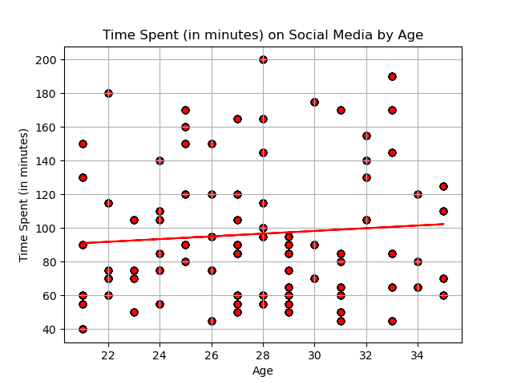
Is there a correlation between age and time spent on social media?
Majority of users are within the ages of 27 - 29.
Most users spend between 40 minutes to 1 hour and 20 minutes on average, per day using social media
Regression line is not narrow and appears more flat.
Best Fit Equation: y = x(0.81) + 74.13
R-value: 0.081
P-value: 0.014
Notes:
The scatter plot doesn’t appear to show any obvious relationships or heavy clusters in certain areas. The areas that appear slightly clustered would be between the ages of 27 and 29 which implies that most users are within the ages of 27 - 29 . On the y axis, the data appears slightly clustered within the 40 to 100 minutes time frame. This indicates that most users spend between 40 minutes to 1 hour and 20 minutes on average, per day using social media. It appears that the line is not as narrow and is more flat. This implies that there is possibly very little relationship between the two variables and the slope is a very small amount. Based on the regression line and the scatter plot, it can be concluded that there is not a correlative relationship between Age and Time Spent on social media. Finally, we ran a correlation test to find the P-value and R-value of the data. The R-value of 0.081 suggest a weak positive correlation between age and usage time meaning that as age increases, there is little to no change in usage time. The P-value of 0.014 indicates that the correlation has some statistical significance meaning that there is sufficient evidence to reject the null hypothesis. In other words, the correlation of the data is not by chance. In conclusion, there is weak positive correlation between these two variable but the data suggests statistical significance.

Slide 13
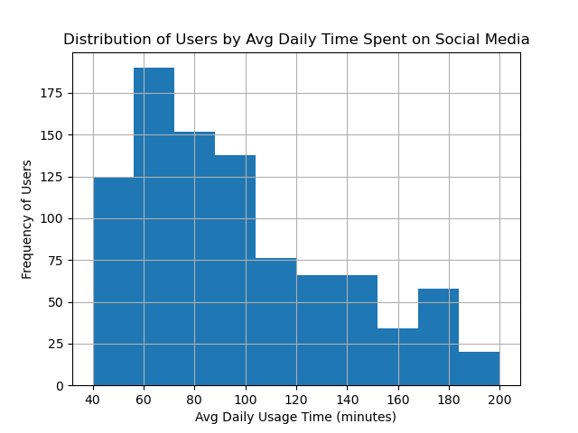
Distribution of Users by Average Time Spent per day on social media
Average, overall time spent on social media: ~96 minutes
Median: 85 min
Mode: 60, 70, 75, 90 min
Standard Deviation: ~39 min (68% of time spent falls within ~46 and ~124 min)
The least amount of time: 40 min
The most amount of time: 200 min
Potential outliers would 1 min or 202 min

Slide 14
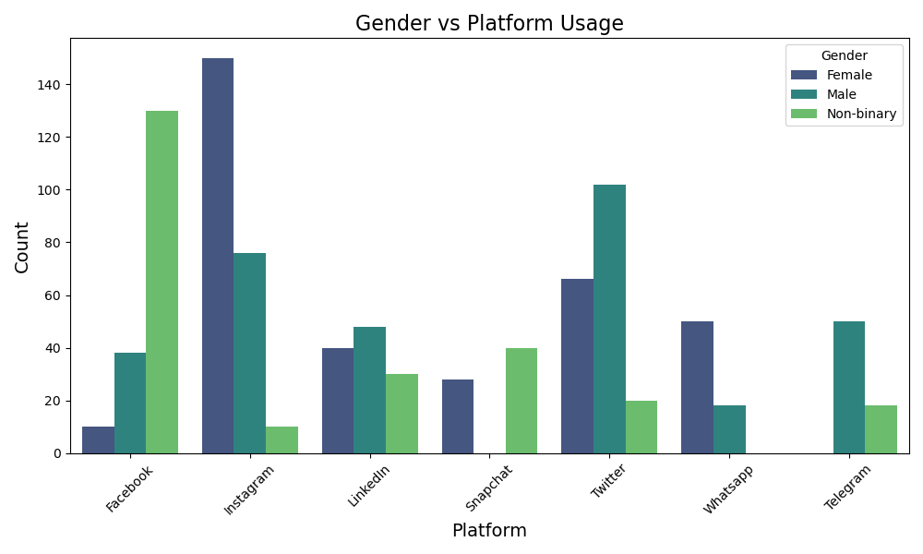
Social media users were categorized as female, male, and non-binary.
Users' preferred platforms were ranked by gender. We used the 'gender' and 'platform' columns for this analysis. As a result of the analysis:
Women's preferred platform was 'Twitter',
Men's preferred platform was 'Instagram', and
Non-binary individuals' preferred platform was 'Facebook'

Slide 15
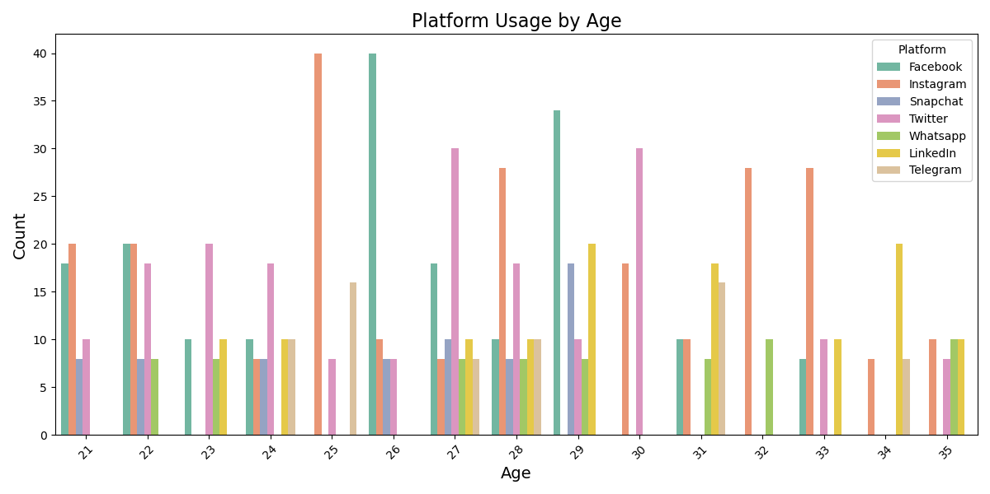
The 'age' and 'platform' columns were used to calculate the average age of social media users, and the average age was found to be 27.5.
In order to increase the accuracy of the data and because 27.5 is not an exact number, first the social media platforms most preferred by 27-year-old users, and then the social media programs preferred by 28-year-old users were evaluated separately.ferred by 27-year-old users, and then the social media programs preferred by 28-year-old users were evaluated separately.

Slide 16
The results showed that the platform used by 27-year-old women, men, and non-binary individuals was 'Twitter.' Meanwhile, the platform used by 28-year-old women, men, and non-binary individuals was 'Instagram.' Thus, the age factor revealed that different genders preferred the same platform.

Slide 17
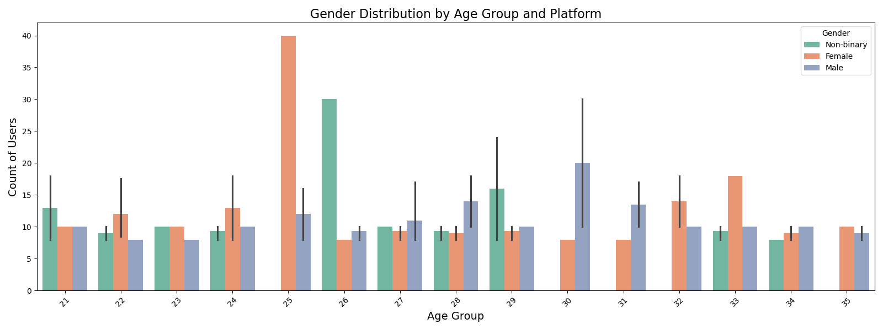
To increase the reliability of the study and to observe how the results may change when analyzing multiple factors, we focused on the most preferred platform by users based on gender and average age (27 and 28). Surprisingly, the most preferred platforms were:
27-year-old women/men: 'Twitter'
28-year-old women/men: 'Instagram'
27-year-old non-binary individuals: 'LinkedIn'
28-year-old non-binary individuals: 'Facebook'

Slide 18
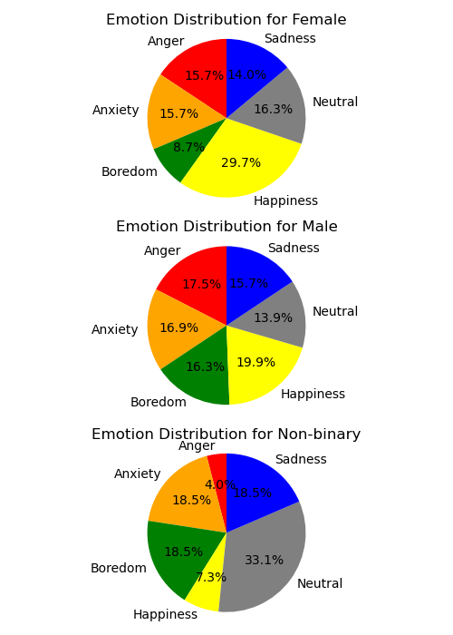
Is there a connection between Genders and their Emotional well-being overall?
🎭
In this data set there are 344 Females, 332 Males, and 248 Non-binary.
Positive Emotions (Happiness):
Females exhibit the highest levels of positive emotions on social media 30%
Neutral Emotions (Boredom/Neutral):
Non-binary exhibit the highest levels of neutral emotions on social media 51%
Negative Emotions (Anger/Sadness/Anxiety)
Males exhibit the highest levels of Negative emotions on social media 50%
Notes:
Is There a correlation between Genders and their Emotional Well-being overall
Used a pie chart easily see the differences between the emotions between each genders
The approach reveals distinct emotion patterns across genders, offering deeper insights into social media engagement.
Happiness is the most dominant emotion among Females 30%,
neutral emotions is the most dominant amust non-binary 51%
Negative emotions is the most dominant 50% amust males at 50%

Slide 19
Comparing the emotional state of individuals using different platforms
Platform distribution:
Instagram had the highest number of users 236
Twitter 188
Facebook 178
Linkedin 118
WhatsApp, Telegram, and Snapchat had an equal but smaller number of users
68 users each.

Slide 20
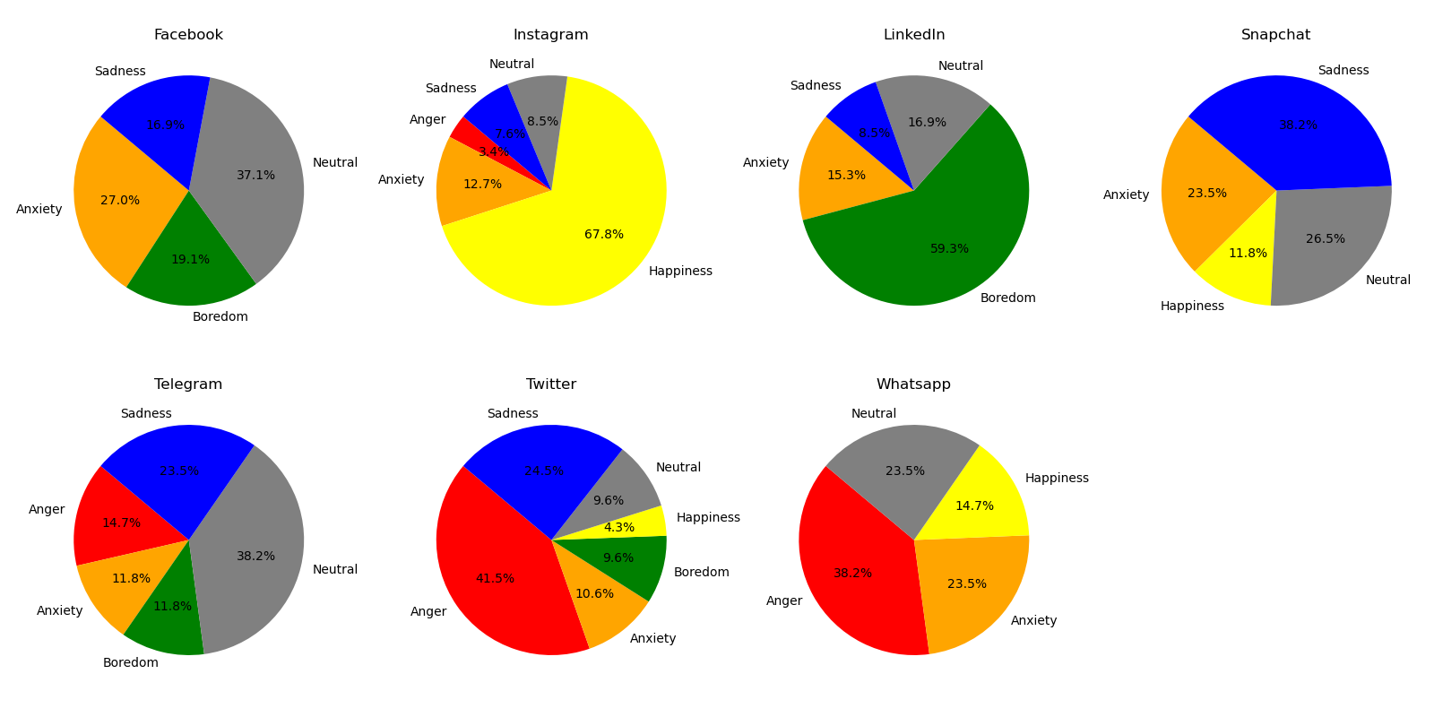
Key Takeaway:
Instagram promotes positive emotions, while Twitter shows emotional diversity with more negative emotions.
Each platform influences emotional well-being differently, reflecting its unique usage patterns and focus.

Slide 21
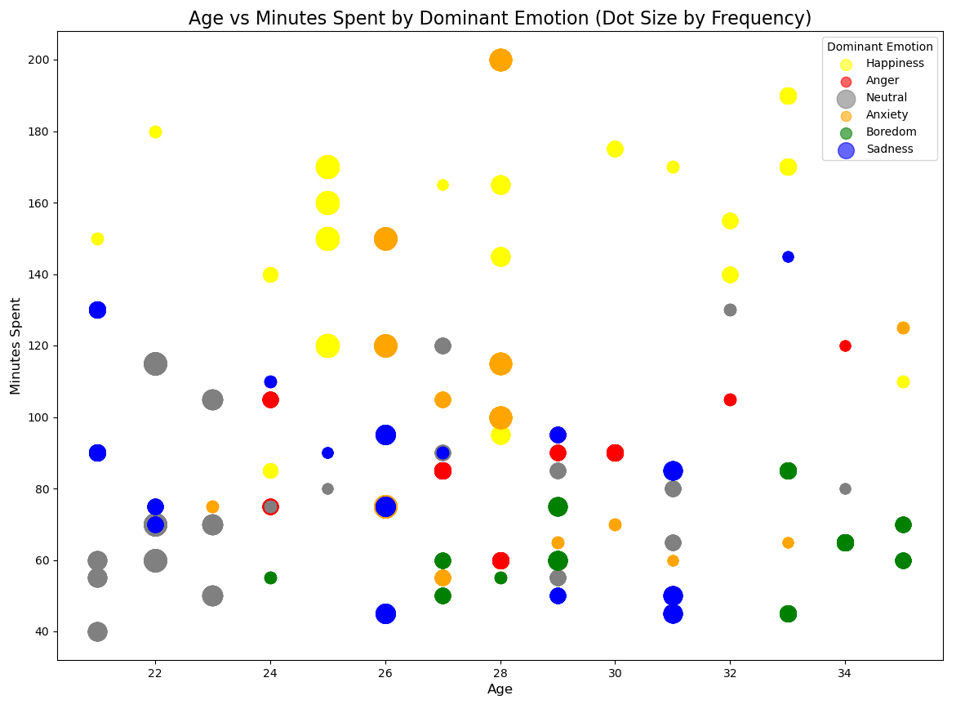
Exploring the connection between Age, Time spent on Social Media, and Emotional Well-Being
Sum of Individual Emotional Count:
186 feels Happiness
184 feels Neutral
156 feels Anxiety
146 feels Sadness
130 feels Boredom
122 feels Anger
Mid-twenties users are most active on social media and are more likely to experience positive emotions during their usage.
Younger age groups show neutral and sadness emotional tendencies
Older age groups show boredom emotional tendencies

Slide 22
Citations
Emirhan BULUT. (2024). Social Media Usage and Emotional Well-Being [Data set]. Kaggle. https://doi.org/10.34740/KAGGLE/DSV/8460631

